Slide 1

ASSIGENMENT – 1
Monitory policy
BBA 1st SEM (2022-23)
Submitted By-
Shankh Bansal
Submitted To-
Dr. Amber Tiwari

Slide 2

Objectives
To know about the effluence of the monitory policy in our daily routine.
To gain a brief knowledge of monitory policy.

Slide 3
Contents : A glimpse of what is to come
Meaning & definition.
Types of inflation.
Cause of inflation.
Effects of inflation.
Control measures.
Present scenario of Indian economy.

Slide 4
Meaning of inflation
In economics, inflation is a rise in the general level of price of good and services in an economy over a period of time. When the general price level rises, each unit of currency buys fewer goods and services.
In a broad sense, inflation is that state in which the pieces of goods and services rise on the one hand and value of money falls on the other.

Slide 5
Definition of inflation
According to prof. Samuelson “inflation occurs when general level of prices & cost are rising”.
“Inflation is an increase in the quality of purchasing power”.
Inflation is the stage of too much money chasing too few goods.

Slide 6
Types of inflation
Creeping inflation
Running inflation
Hyper inflation

Slide 7
Creeping Inflation
“When the rise in price is very low like that of a snail or creeper, is called creeping inflation”.
Here the inflation rate is up to 5%.
The general level of prices rise at a moderate rate over a long period of time.

Slide 8
Running Inflation
Running inflation has inflation rate between 8-10 %. A sense of urgency needs to be shown in controlling the running inflation.
Persistent running inflation reduces the saving in the economy and result in slowdown in economic growth.

Slide 9
Hyper inflation
Prices rise very fast at double or triple digit rate.
Also called runway or Galloping inflations.
This type of inflation is seen in the past in many countries.
Many developed and industrialized countries like Italy and japan also witnessed the hyper inflation in the past.

Slide 10
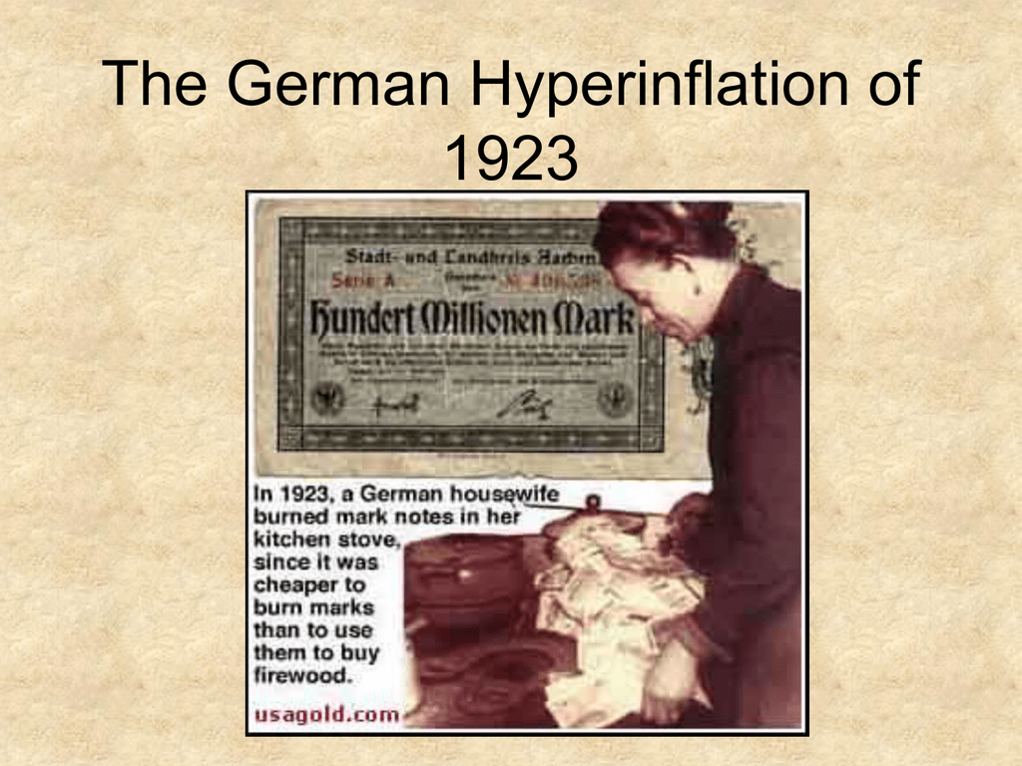

Slide 11
Causes of Inflation
There are two main causes for inflation which is stated as below :
Demand – pull inflation
Cost – pull inflation

Slide 12
Demand Pull Inflation
The demand for goods and services increases and production remains the same or does not increases as fast. The excess demand results in price bring “pulled up”.
Demand pull inflation occurs when total demand for goods and services exceeds the total supply.
This type of inflation happens when there is an inflationary gap.

Slide 13
Causes of demand pull inflation :
Increase in consumption, perhaps expectations of future inflation.
Increase in investment caused by falling interest rates or expectations of a booming economy.
Increase in government spending or a decrease in taxes, either of which would boost deficit spending.
Increase in exports to other nations or a decline in imports from other nations.

Slide 14
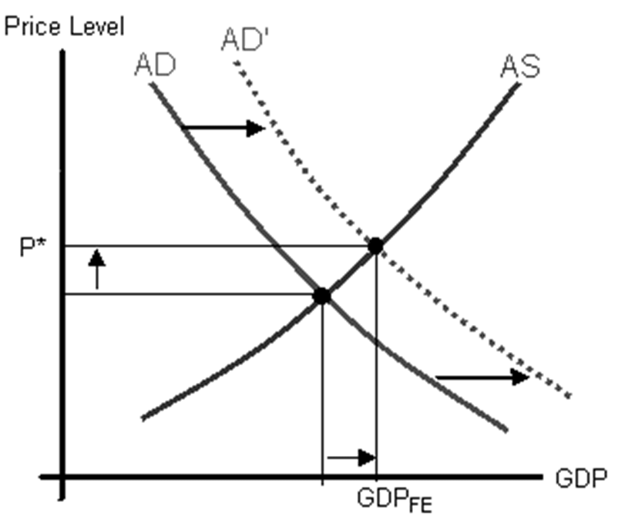

Slide 15
Cost pull inflation :
Cost pull inflation explains the causes of inflation origination from the supply side.
It is caused by an increase in the cost of production. Increased cost “push up” the price level.
This occurs when cost of production or operation are increasing.

Slide 16
Cost pull inflation is caused mainly due to :
Increase in wages.
Increase in cost of raw materials.
Increased cost of imported components (import-push inflation )

Slide 17
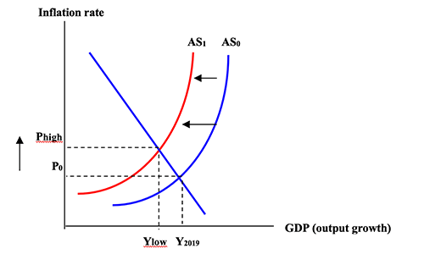

Slide 18
Effects of inflation
Effect depends on the speed of inflation and the nature of the economy.
Rising prices of imports.
Lowers national savings.
Redistribution of income & wealth.
Collapse of monetary system.
Adverse impact socially & politically.
Discourages investment & savings.
Higher interest/ Income tax rates.

Slide 19

Control measures

Slide 20
Measure to control inflation
Fiscal measures.
Monetary measures.
General measures.

Slide 21
Fiscal measures
Increase in direct taxes.
Increase in indirect taxes.
Reduce government spending.
Introduce measures to increase productivity, e.g. tax, rebates and subsidies.
Surplus budget.

Slide 22
Monetary policy
Increase interest rates of banks.
Decrease money supply.
Decrease availability of credit from banks.
Issue of new currency.
Credit control.

Slide 23
General Measures
Increase productivity.
Freeze prices and wages.
Implement a wage restraint policy.
Encourages personal savings.
Import control :makes competition important goods cheaper.
Introduce price indexation: linking all prices to a particular index, e.g. CPL.
Implement control measures for consumer credit.

Slide 24
Meaning of inflation rates
The inflation rate is a measurement of the rise in prise of a good or services over a period of time reflected as a percentage.it is usually measured on a monthly and annual basis.
The inflation rate is the percentage rate of change of a price index over time.

Slide 25
Calculation of inflation rate
The Inflation rate is widely calculated by calculating the movement or change in a prise index, usually the consumer price index.
In order to calculate the inflation rate for any product or services, you will need the price of the good for two periods of time, then use the following formula to calculate the inflation rate :
Inflation Rate = {(T2-T1)/T1} *100

Slide 26
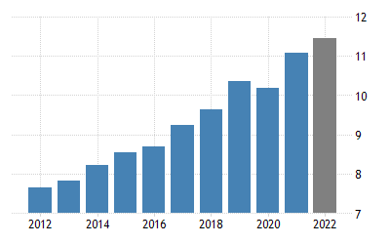
Present scenario of Rwandan economy
The inflation rate in Rwanda was recorded at 0.20 present in February of 2015. inflation rate in Rwanda averaged 6.23 % from 1997 until 2015, reaching all time high of 28.10 % in February of 1998 and a record low of -15.80 present in February of 1999.

Slide 27

Key takeaways
Central banks today primarily use inflation targeting in order to keep economic growth steady and prices stable.
With a 2-3% inflation target, when prices in an economy deviate the central bank can enact monetary policy to try and restore that target.
If inflation heats up, raising interest rates or restricting the money supply are both contractionary monetary policies designed to lower inflation.

Slide 28

Learning outcomes
Grasped in-depth knowledge about monitory policy.
Got to know who change in policy will change my business.

